Slide 1
MGT388 Finance and Law for Engineers
Break-even point

Slide 2
Break-even Point
Break even point is the point at which neither a profit nor a loss is made.
It is the point where the total revenue of a business is equal to the total costs.
The total costs of the business are the variable costs and the fixed costs.

Slide 3
Variable costs and Fixed costs
Variable costs vary in direct proportion with volume of activity.
Cost
Variable cost
Output

Slide 4
Variable and Fixed Costs
These costs remain constant over wide ranges of activity.
cost
Fixed cost
Output

Slide 5
Break-Even Point
Break-even point can be seen on a break-even chart or a cost-volume-profit chart (CVP)
£ Sales Revenue
Total costs R
Q Quantity

Slide 6
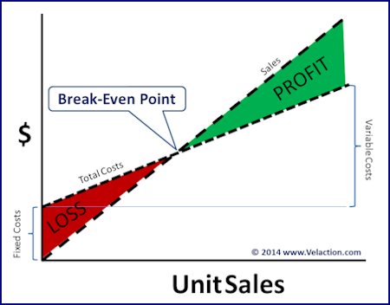
Break-even point

Slide 7
Break-even Point
Sales revenue – variable cost –fixed costs =0
SP x Quantity – VC x Quantity – fixed cost = 0
Quantity (SP –VC) – Fixed cost = 0
Break even point (quantity) = Fixed costs
Contribution

Slide 8
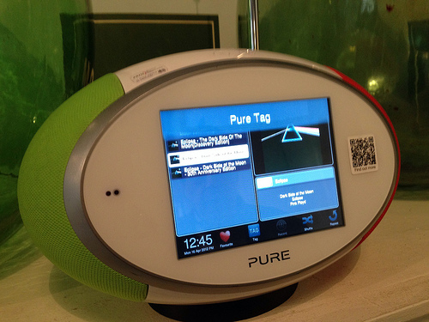
Break even point
Using the formula the number of units that need to be produced and sold to break-even can be calculated.
Example
A company manufactures and sells digital radios. The selling price is £75, the variable costs are £45 and fixed costs are £60,000
Calculate the break-even point

Slide 9
Break-even Point
Break-even point = Fixed costs
Selling price – variable cost
Break-even point = 60,000
£75-£45
Break-even point= 2,000 radios
Check
2,000 X £75 – 2,000x £45 - £60,000 = 0
150,000 - 90,000 - 60,000 =0

Slide 10
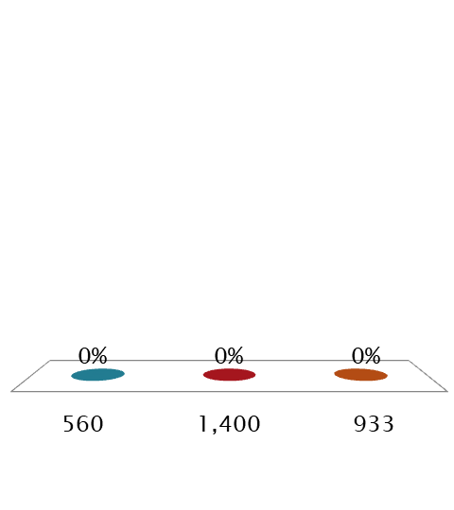
Calculate the BEP for digital radios if fixed costs could be reduced to £42,000. Sales price £75 and variable cost £45
560
1,400
933

Slide 11
Answer
BEP = 42,000 = 1,400 units
£75-£45

Slide 12

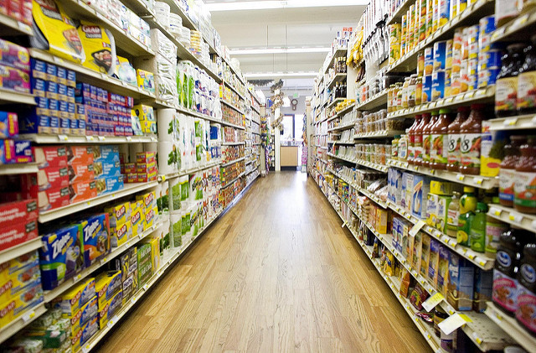
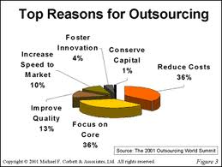
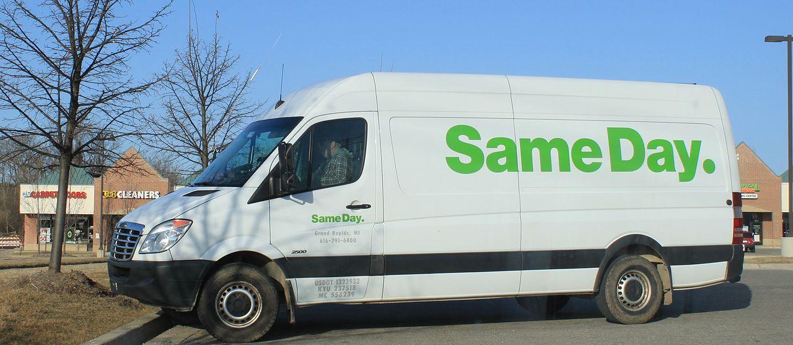

Business Can Reduce Fixed Costs

Slide 13

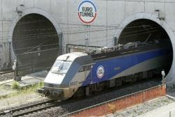
What If fixed costs are high?
Business with high research and development or initial set up costs will have high fixed costs. To bring down the cost per unit a high sales volume is needed.
Computer games, such as Call of Duty, can cost £35m to produce, the only way to recoup this is to have a high sales volume.
Eurotunnel reached cash break-even in 2003 having opened in 1994 the Chief Executive stating the problem being the tunnel is an “under utilised piece of kit”.

Slide 14
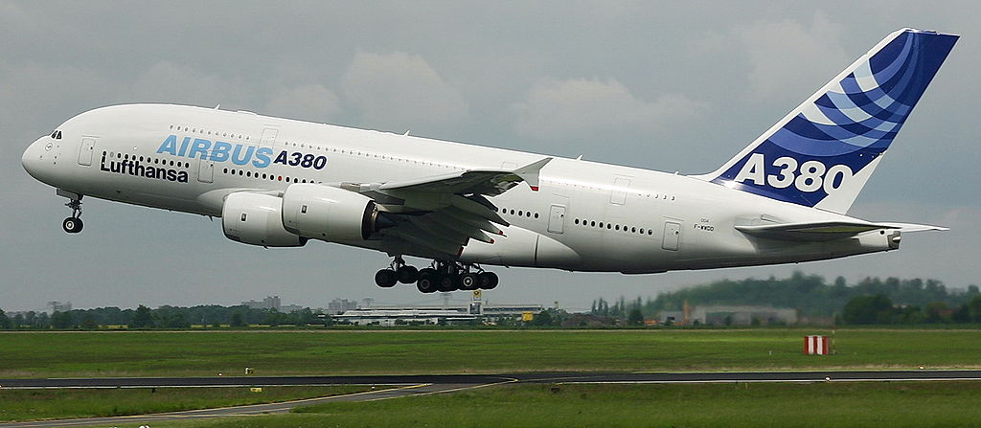
Airbus: July 16
Airbus aims to cut production in A380s from 27 in July 2015 to just 12.
The company broke-even when delivering 27 planes and is aiming to break-even at 20 planes by targeting additional cost reduction initiatives.

Slide 15
Target profit
Where a business wishes to make a certain level of profit the break-even formula should be used. The target profit added to the fixed costs figure.
For the company making digital radios calculate the number of units that must be produced if a profit of £48,000 is required.
Sales price £75, Variable costs £45, Fixed costs £60,000.

Slide 16
Break-even Point
Units to achieve target profit
Fixed costs + target profit
Sales price – variable cost
£60,000 + £48,000 = £108,000
£75-£45 £30
3,600 radios
Check
3,600 X £75 -3,600X£45 -£60,000 = £48,000
270,000 – 162,000 -60,000 =48,000

Slide 17
Margin of Safety
The margin of safety is the excess of planned or actual sales above break-even point.
This can be expressed as a percentage of the sales estimate.

Slide 18
Break-even point
Margin of safety
Planned sales 3,600 @£75 £270,000
Break-even point 2,000 @£75 £150,000
Margin of safety 1,600 £120,000
Expressed as a percentage 1,600 = 40%
3,600

Slide 19
Break-even point
The management are considering buying a new piece of machinery which will reduce variable costs but cause fixed costs to increase by £18,000.
To maintain the current profit of £48,000 what will variable costs have to go down to?
Fixed costs were £60,000, variable costs £45 and sales price £75, sales quantity 3,600 radios.

Slide 20

New variable costs need to be
£5
£40
£35

Slide 21
Answer
Fixed costs 60,000 + 18,000 = £78,000
Fixed cost + desired profit = 78,000+48,000
=126,000
3,600 units = 126,000
75- x
270,000-3,600x = 126,000
X = £40

Slide 22
Uses of Break-even
Initial Price setting
On starting a business-high level of fixed costs
You may not be able to achieve a high sales volume so do you set price high to start or just at level to cover re-occurring fixed costs.
Business plan
Know the expected sales targets and margin of safety then an indication of business risk

Slide 23
Uses of break-even
Marketing
Can add the cost of marketing to fixed costs to see extra sales quantity need to achieve.
Where looking to offer a discount can look at extra quantity to maintain profits

Slide 24
Limitations of break-even
Unrealistic assumptions – semi-variable cost
All units produced are not always sold
Variable costs change with output (bulk discount)
Many businesses make more than one product

Slide 25


